Slide 1
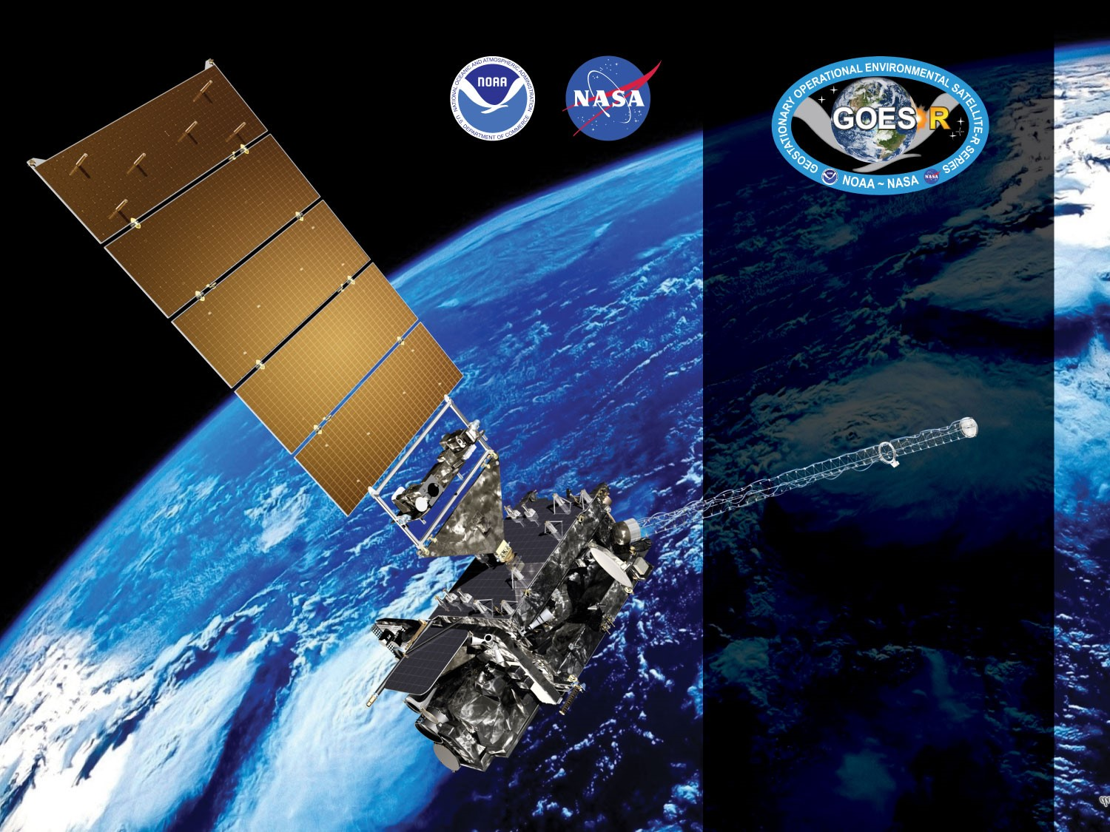
GOES-17 ABI L2+ Nighttime Cloud Optical and Microphysical Properties Provisional PS-PVR
Revisit
September 24, 2019
Pat Heck, William Straka III
(CIMSS)
Team Lead: Andrew Heidinger
(NOAA/NESDIS/STAR)
GOES-R AWG

Slide 2
NCOMP Requirements
Product | Range | Accuracy | Precision | Latency | Horizontal resolution
Cloud Optical Depth | 1 < COD < 8 | 20% (liquid) 30% (ice) | max of 0.8 or 35% | 5min | 2km
Cloud Particle Size | liquid: 2 < CPS < 32μm ice: 2 < CPS < 50μm | 4μm (liquid) 10μm (ice) | 100% (liquid) 45% (ice) | 5min | 2km
Liquid Water Path | 25 < LWP < 100 | max of 25 gm⁻² or 15% | max of 25 gm⁻² or 40% | 5min | 2km
NCOMP generate for Solar Zenith angles greater than 82º but accuracy and precision requirements only apply to SZA greater than 90º
Liquid water path (LWP) and Ice Water Path (IWP) are future capabilities. They are calculated from COD and CPS. LWP in particular helps to evaluate the products above.

Slide 3
Application of PLPT Quantitative Analysis Tests to each Domain
Our 3 PLPTs dealing with analysis are comprised of 4 methods.
Each contains the applications of these methods on some combination of FD, CONUS and MESO domains.
The applications of each method to each domain is summarized below.
Some methods were redundant or not feasible for some domains.
Analysis Method | FD | CONUS | MESO
Visual Inspection
Comparison to other COP algorithms
Comparison of COD to CALIPSO
Indirect comparison of CPS to other LWP (AMSR-2)
3

Slide 4
GOES-17 Data Used in this Review
2 Days from May 2019 - Visual inspection of FD, CONUS and Meso domains.
31 Days from December 2018 - FD subsets with simultaneity with CALIOP and AMSR-2.
Note that the NCOMP algorithm version and all inputs for both time periods are the same. Both are Ground System products.
4

Slide 5
Definitions of Metrics
Passed: No visual artifacts and/or COP meet F&PS.
Partial-Passed: COP meet F&PS with or without visual artifacts. Dominant issues are known.
Failed: COP do not meet F&PS. Cause of performance degradation is under investigation.

Slide 6
Examples of Visual Inspection of All Domains
Note: slides in the visual inspection section have not changed since the earlier presentation and are included for the sake of completeness. Products are from a period when the loop heat pipe issue was more prevalent than in the period used for the later validation results, but they exhibit that the different domain products are as expected.

Slide 7
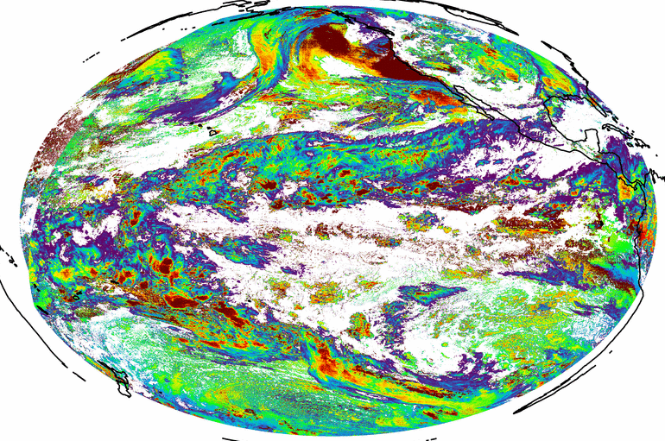
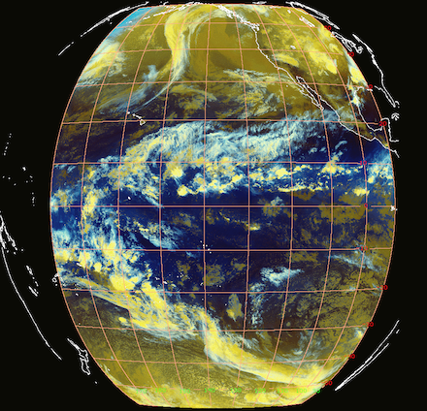
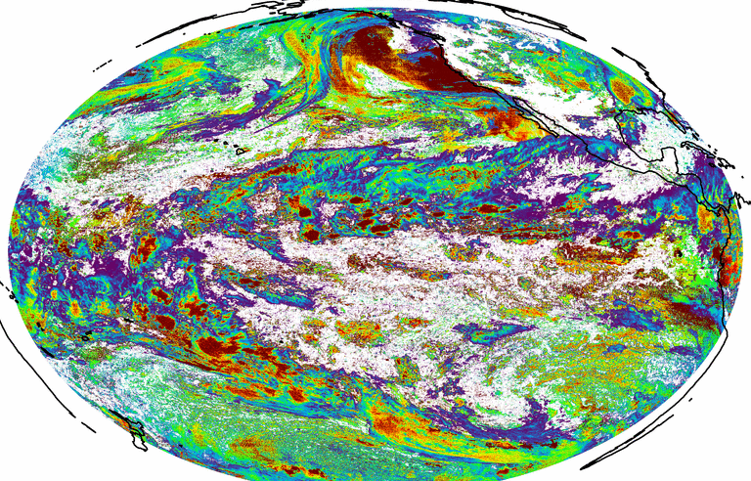
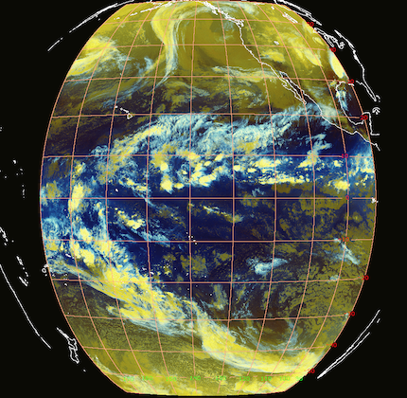
PLPT ABI-FD_COD03:
COD Full Disk
May 9, 2019
0600 UTC
May 9, 2019
0900 UTC
PASSED

Slide 8
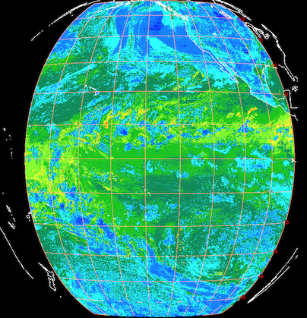
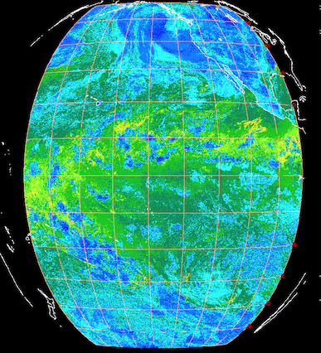
PLPT ABI-FD_COD03:
COD Full Disk
May 9, 2019
0600 UTC
May 9, 2019
0900 UTC
BTD 11.2 - 12.3 µm
PASSED

Slide 9
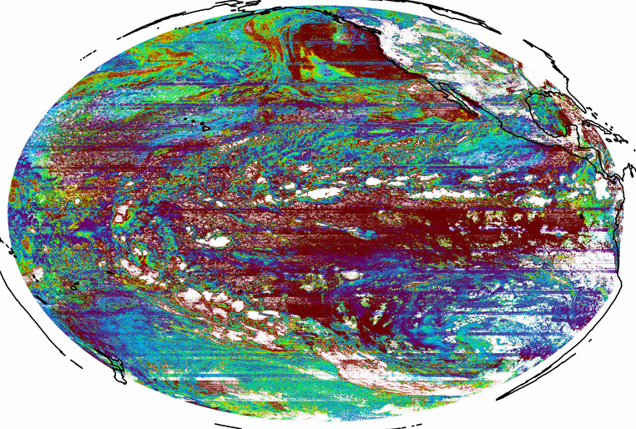
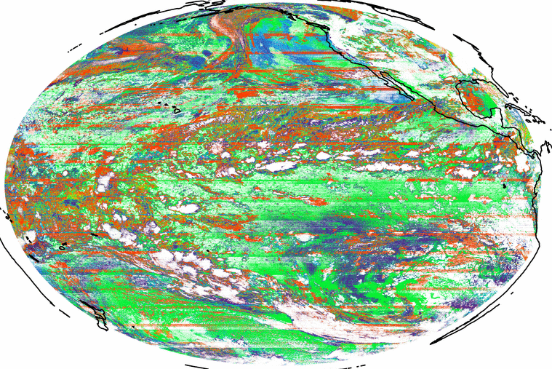
PLPT ABI-FD_COD03:
COD Full Disk
May 9, 2019
1200 UTC
CPS Full Disk
May 9, 2019
1200 UTC
microns
PASSED

Slide 10
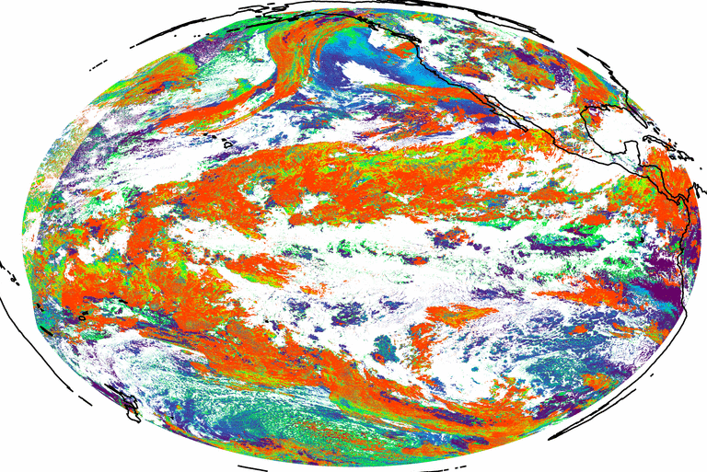
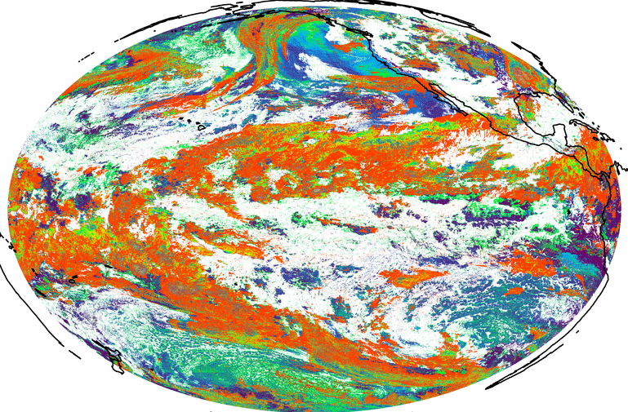
PLPT ABI-FD_COD03:
CPS Full Disk
May 9, 2019
0600 UTC
May 9, 2019
0900 UTC
microns
PASSED

Slide 11
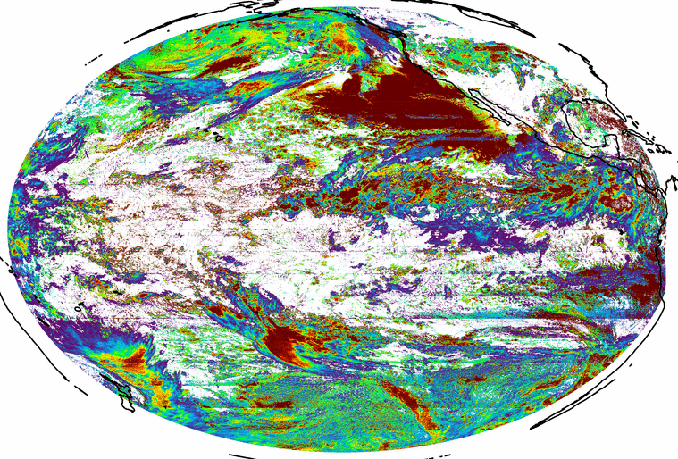
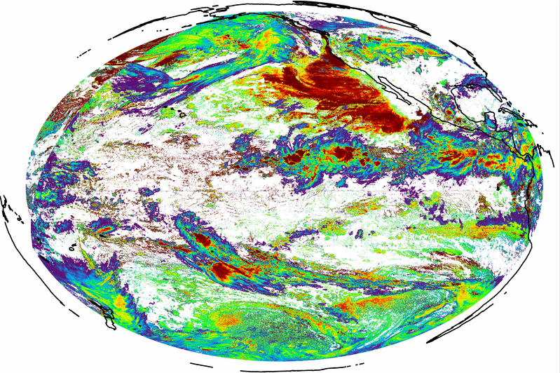
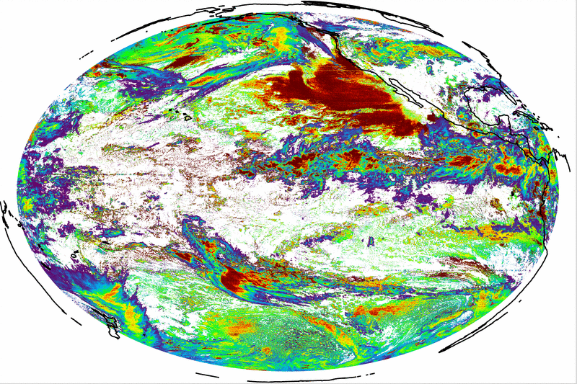
PLPT ABI-FD_COD03:
COD Full Disk
May 28, 2019
1200 UTC
high COD and striping
May 28, 2019
0600 & 0900 UTC
PASSED

Slide 12
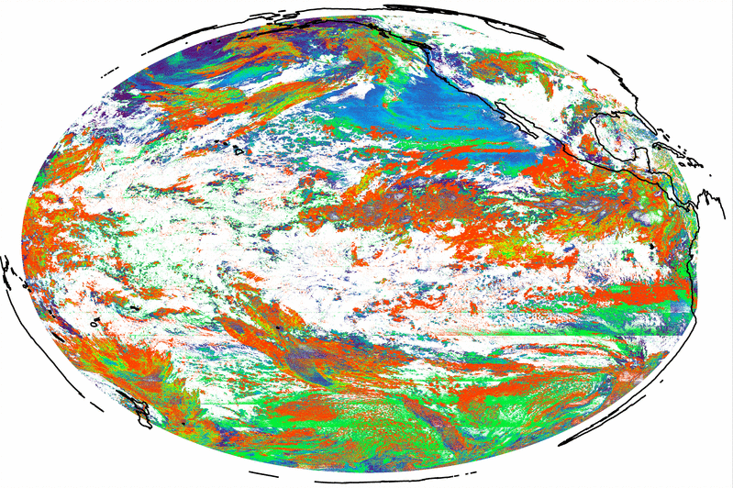
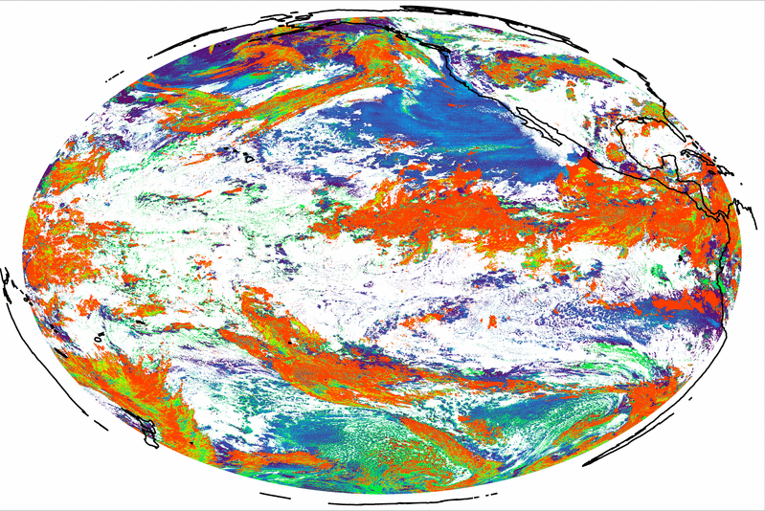
PLPT ABI-FD_COD03:
CPS Full Disk
May 28, 2019
1200 UTC
microns
Higher CPS and striping
May 28, 2019
0900 UTC
PASSED

Slide 13
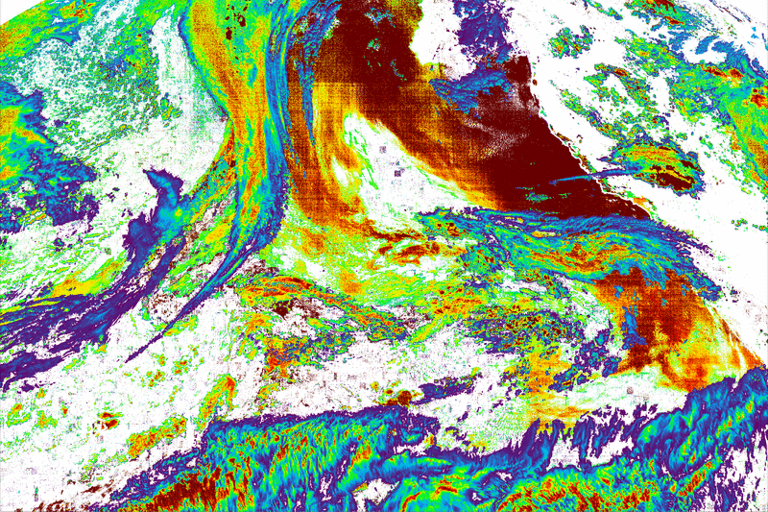
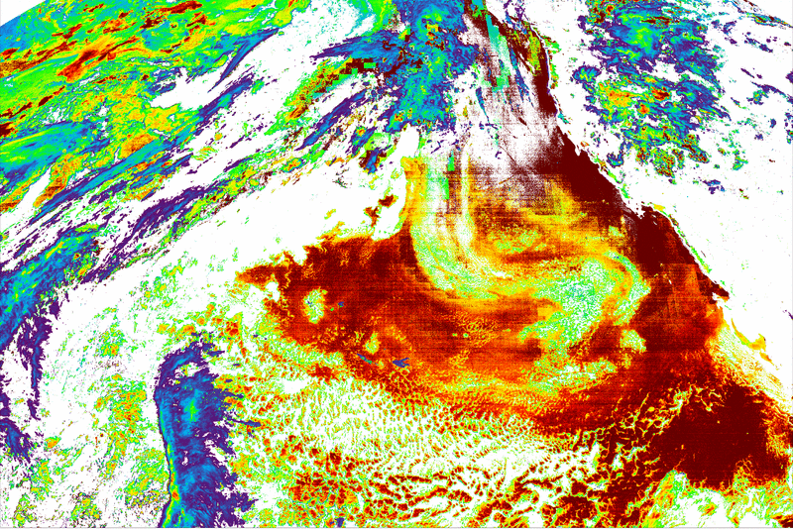
PLPT ABI-CONUS_COD03:
COD CONUS
May 9, 2018
0901 UTC
May 31, 2018
0901 UTC
PASSED

Slide 14
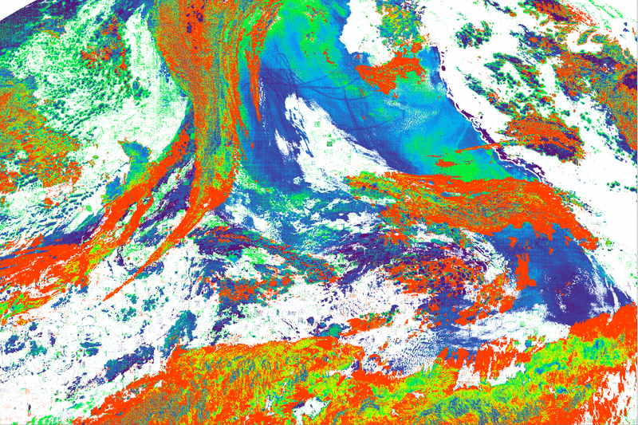
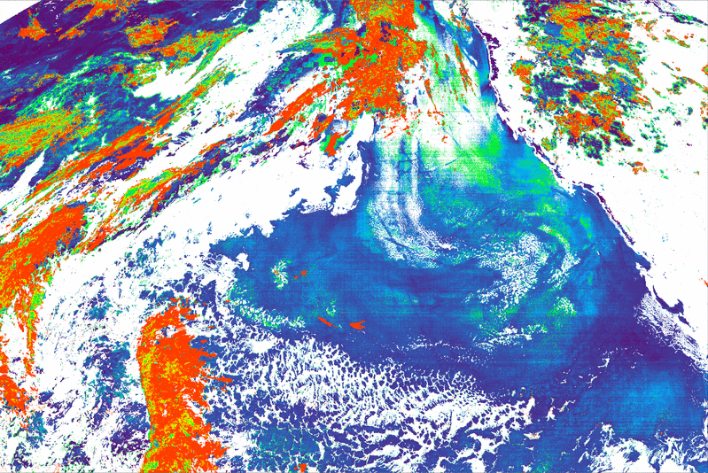
PLPT ABI-CONUS_COD03:
CPS CONUS
May 9, 2018
0901 UTC
May 31, 2018
0901 UTC
PASSED

Slide 15
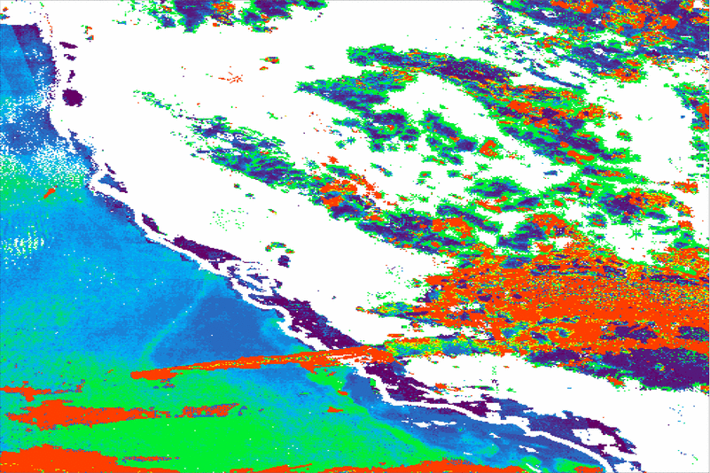
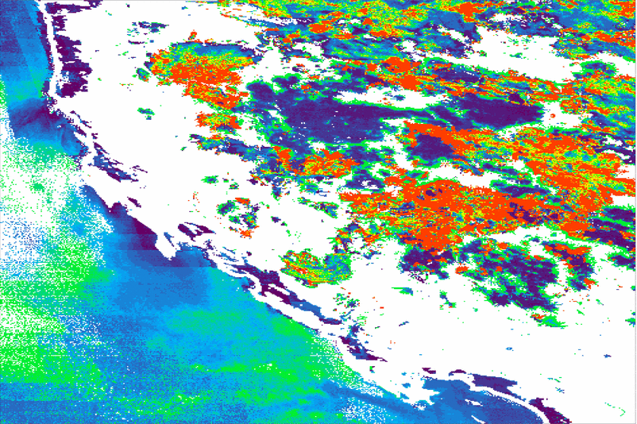
PLPT ABI-MESO_CPS02:
CPS MESO-1
May 9, 2018
0901 UTC
May 31, 2018
0901 UTC
PASSED

Slide 16
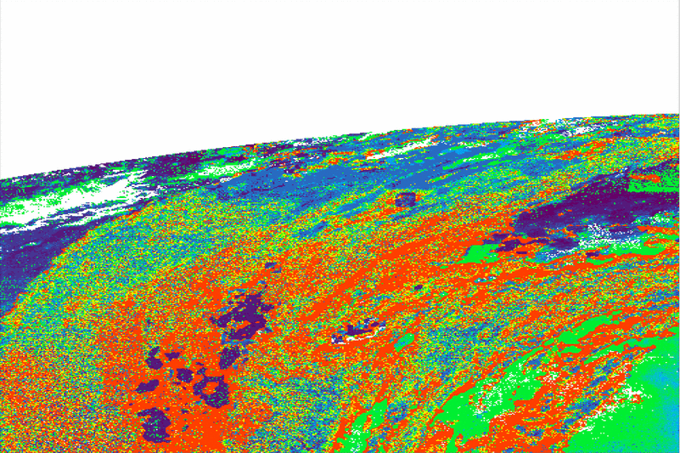
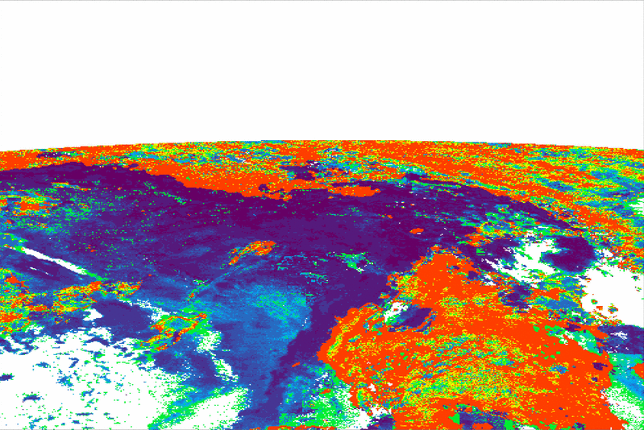
PLPT ABI-MESO_CPS02:
CPS MESO-2
May 9, 2018
0901 UTC
May 31, 2018
0901 UTC
PASSED

Slide 17
Comparison to NASA CALIPSO/CALIOP COD
Note: This section updated to support the revisit.

Slide 18
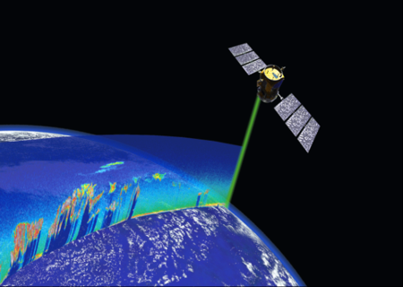
CALIOP vs ABI Comparison Description: COD
CALIOP is a lidar on board of CALIPSO.
CALIOP Cloud algorithm results are considered as “Truth” for presence of clouds and some other applications, but CALIOP’s COD is less certain .
31 days from Dec. 2018 of CALIOP and ABI matched data are used. The loop heat pipe problems are minimized in this period.
Using CALIOP Version 3.4, 5-km product, as was used for GOES-16 validation.
Using CloudSat GEOPROF-LIDAR product to establish cloud base (avoid multi-layer/thicker clouds)
https://www.globe.gov/web/calipso
Filters applied to CALIOP
Non-opaque ice clouds, constrained retrievals only
Varied adjacent cloud fraction requirements
Filters applied to GOES-17:
Scan time difference ± 10 minutes

Slide 19
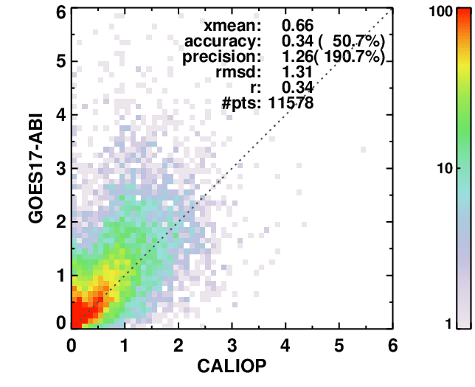
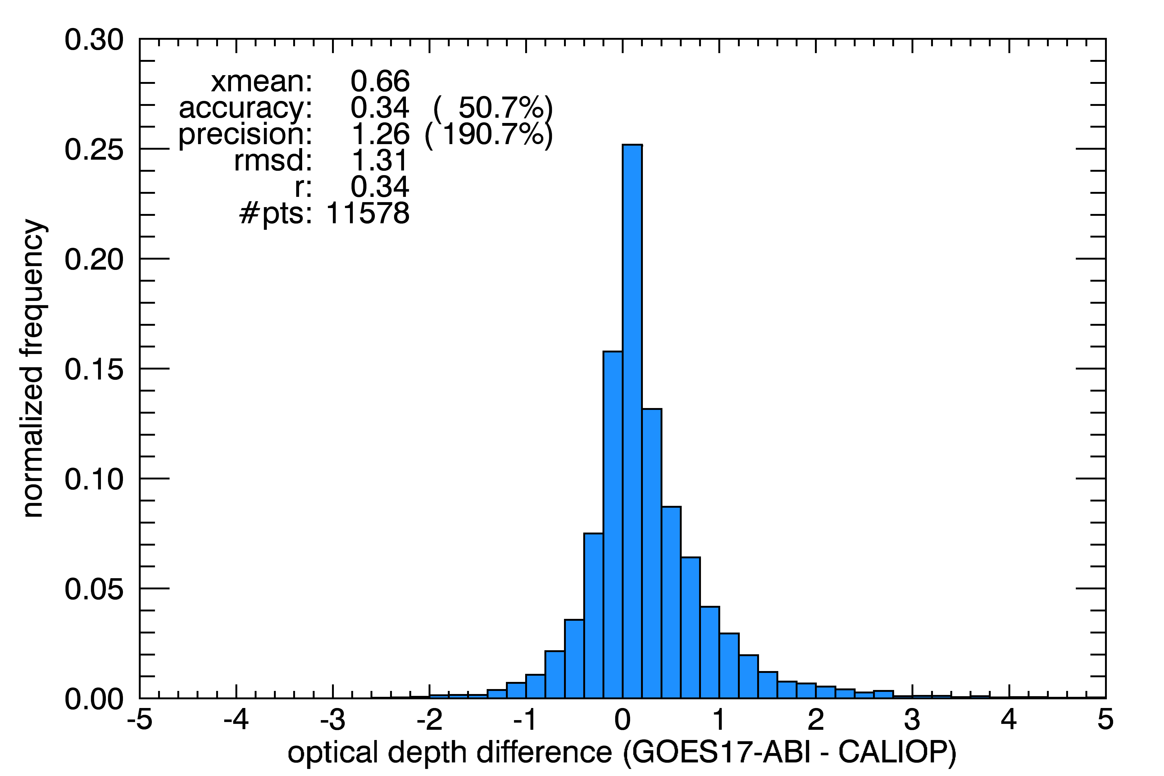
CALIOP vs ABI Comparison: COD
Matches from all 31 days, no twilight
CALIOP 15-km cloud feature horizontal extent
Accuracy results do not meet F&PS specs, which is as anticipated.
Precision results show relatively large disagreements.
In order to assure that these 2 disparate instruments are looking at the same clouds, filtering is needed (next slides).
Accuracy requirement for ice: 30%
Precision requirement for ice: 0.8 or 35%
Notes:
Red text = requirement not met

Slide 20
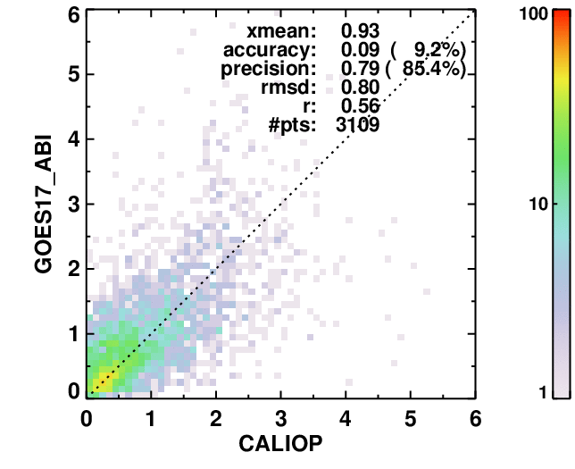
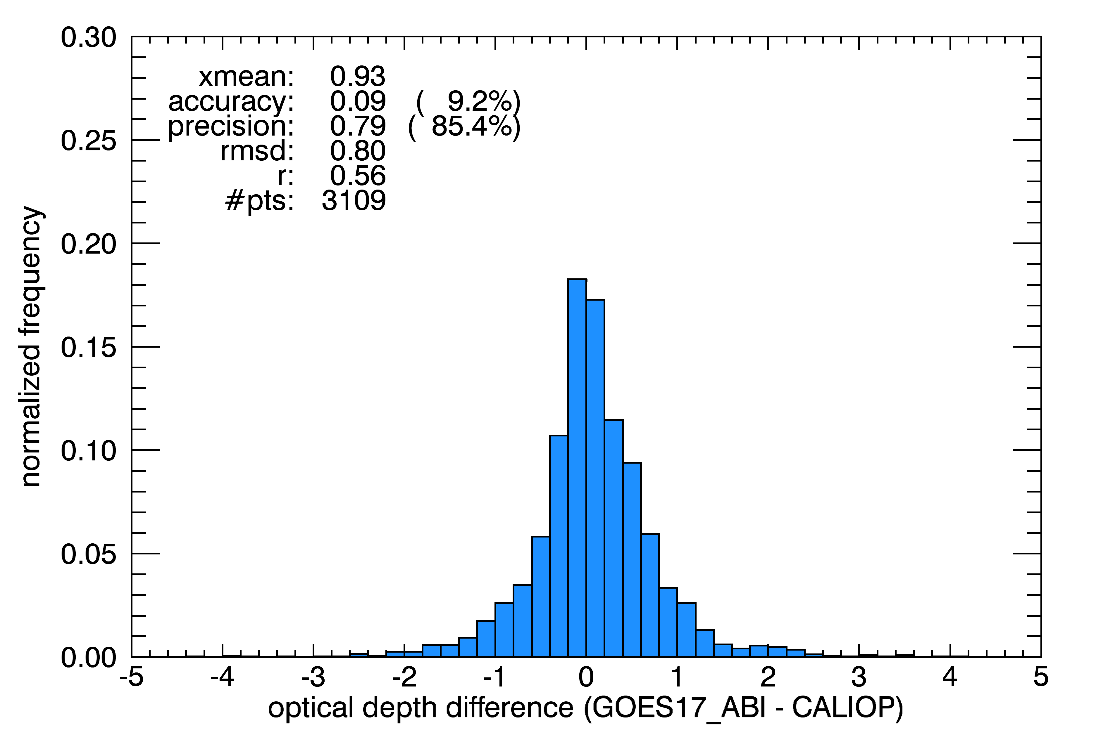
CALIOP vs ABI Comparison: COD
Same as previous slide, but CALIOP 25-km cloud feature horizontal extent.
Accuracy results now easily meet F&PS specs.
Precision results improve.
Accuracy requirement for ice: 30%
Precision requirement for ice: 0.8 or 35%
Notes:
Green text = requirement met

Slide 21
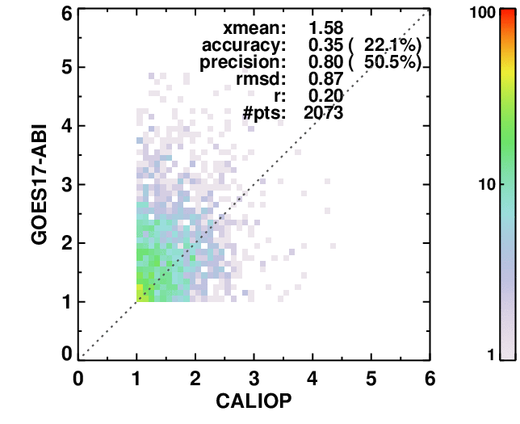
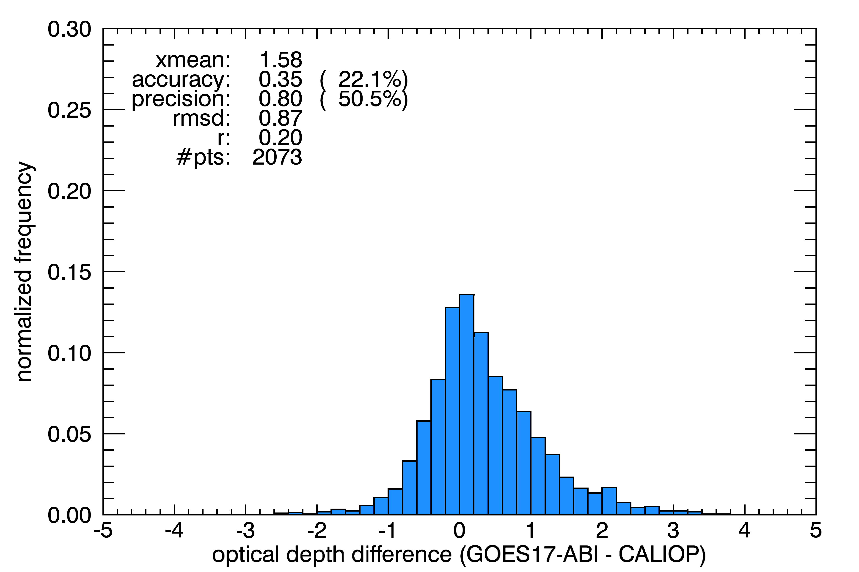
CALIOP vs ABI Comparison: COD
Same, but narrow the low end to NCOMP requirement minimum of 1.0.
Accuracy results still meet F&PS specs.
Precision still meets 0.8 spec, but slightly higher in %
Accuracy requirement for ice: 30%
Precision requirement for ice: 0.8 or 35%
Notes:
Yellow text = close to meeting requirement

Slide 22
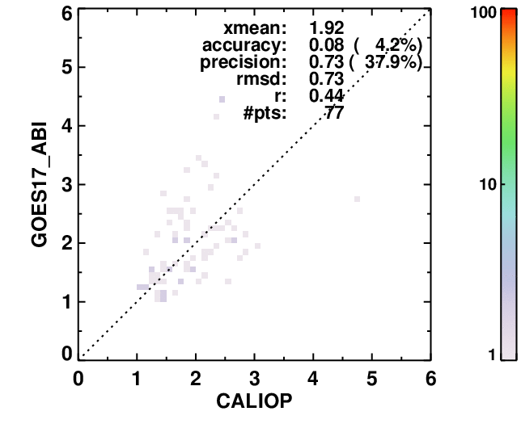
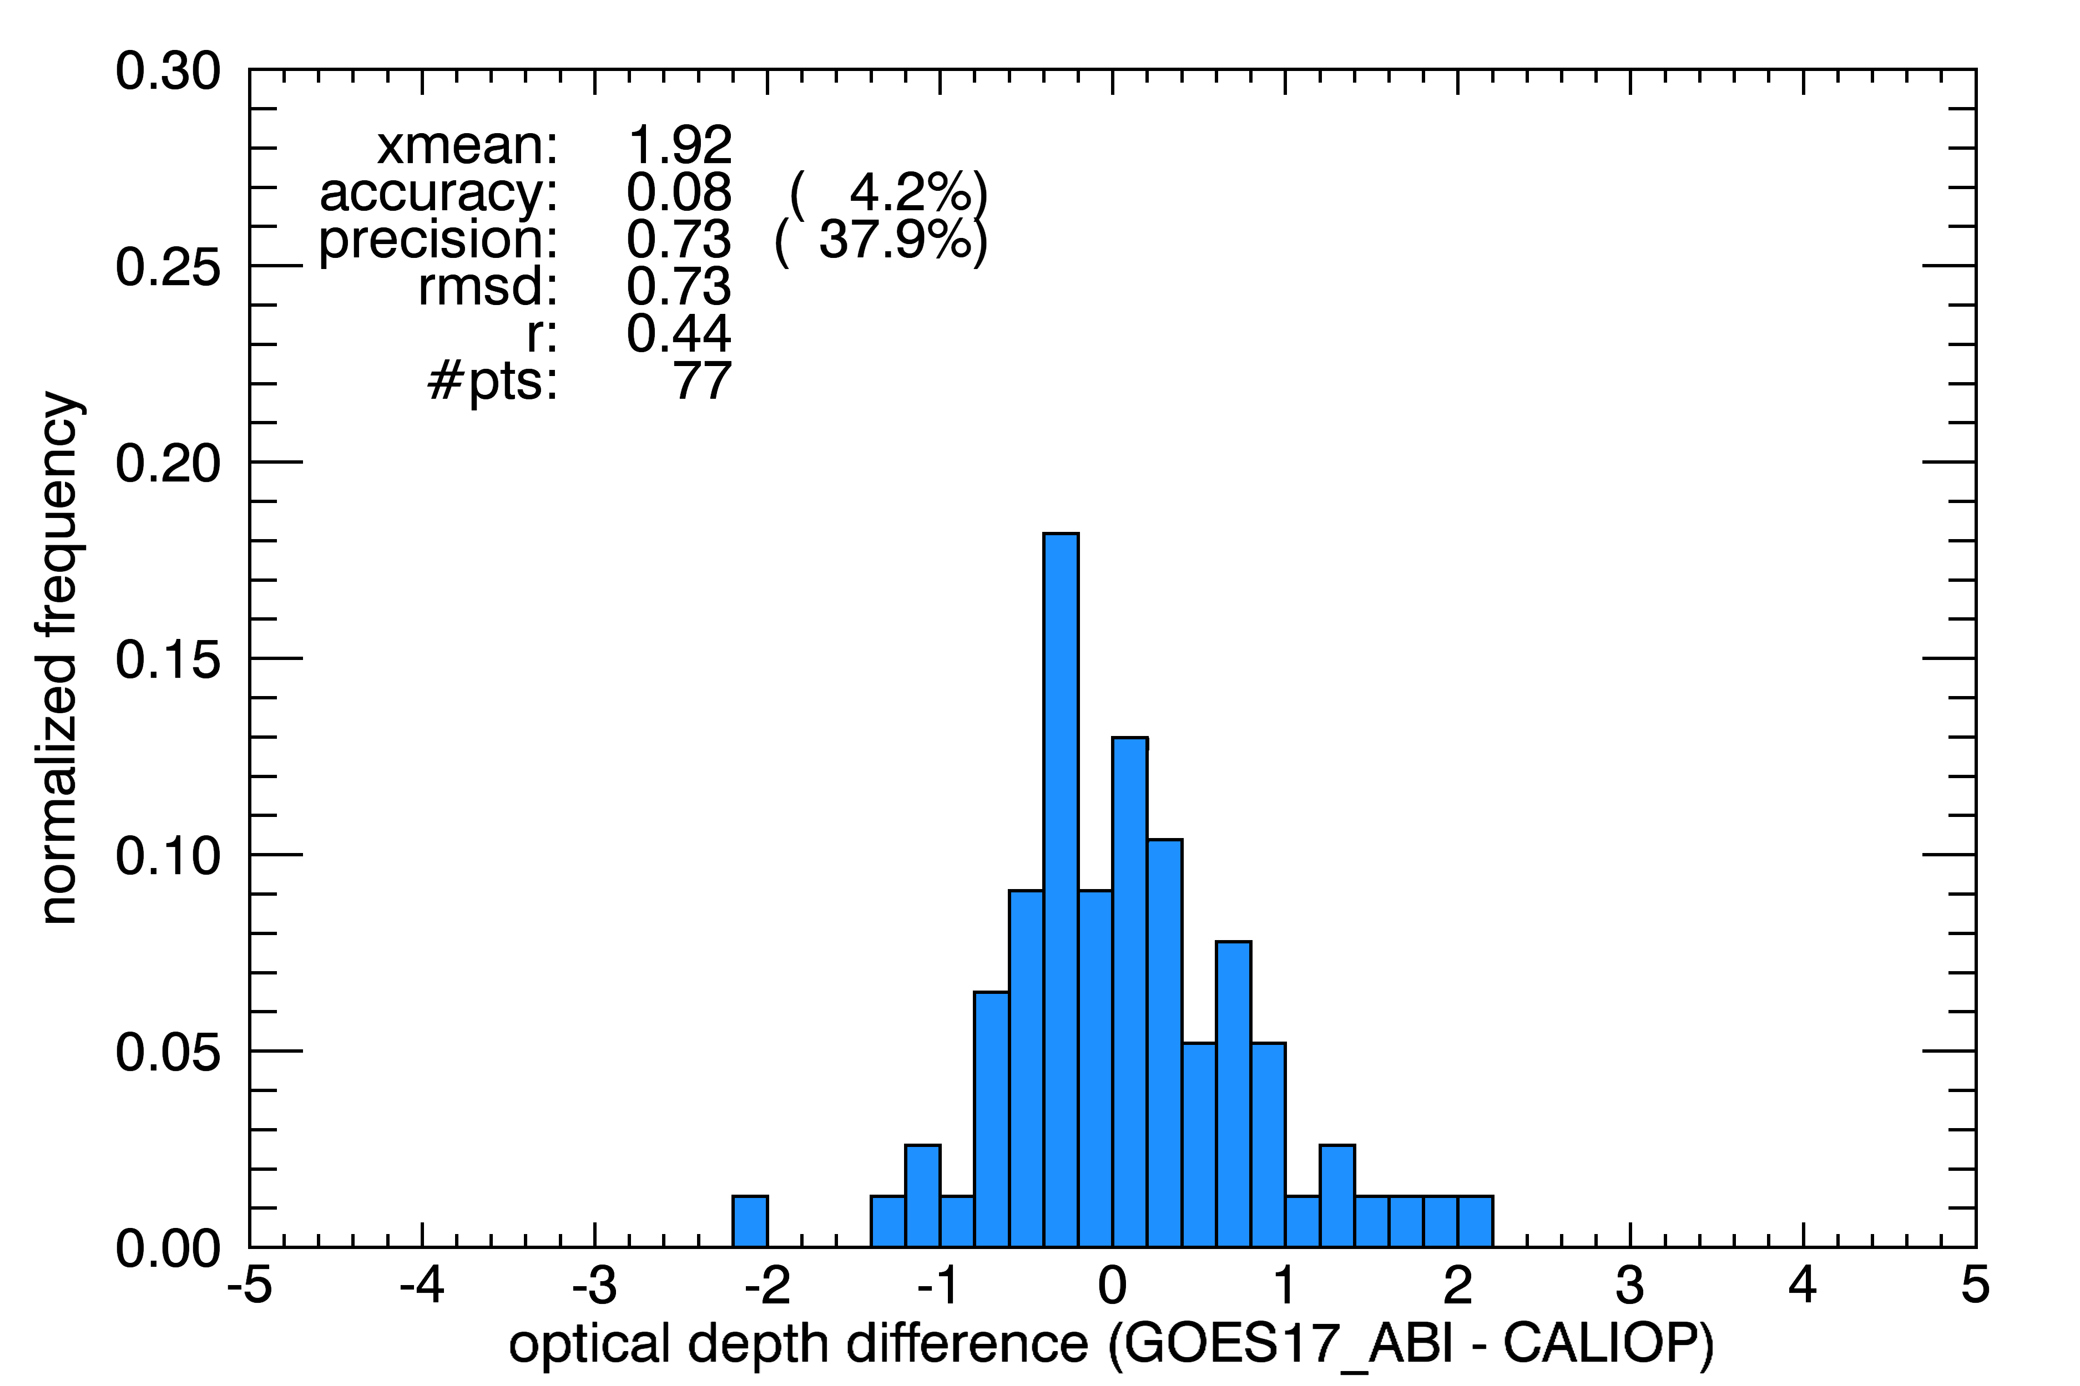
CALIOP vs ABI Comparison: COD
Same, but use CALIOP 45-km cloud feature horizontal extent to assure homogenous cloud features.
Accuracy results still meet F&PS specs.
Precision still meets 0.8 spec, improves in terms of %.
Very limited sample, but those are the available matches for 1 month of full disk data.
Accuracy requirement for ice: 30%
Precision requirement for ice: 0.8 or 35%

Slide 23
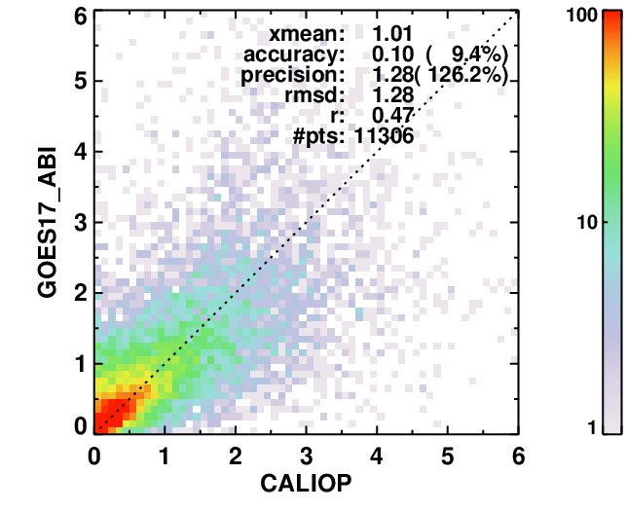
CALIOP vs ABI Comparison: COD
Now trying CALIOP Version 4.2 with 15-km cloud feature horizontal extent to assure homogenous cloud features.
Both precision and accuracy are improved compared to V3.4.
Most of this due to improved overall CALIOP algorithm that includes various detection/masking both horizontal and vertical.
Using 3.4 for comparisons for consistency with GOES-16 and due to other V4.2 changes discussed later.
Accuracy requirement for ice: 30%
Precision requirement for ice: 0.8 or 35%
V4.2
V3.4

Slide 24
NCOMP COD Requirements vs. Validation
May Requirements
Product | Range | Accuracy | Precision | Latency | Horizontal resolution
Cloud Optical Depth | 1 < COD < 8 | 20% (liquid) 30% (ice) | max of 0.8 or 35% | 5min | 2km
Performance
Product | Range | Accuracy | Precision | Latency | Horizontal resolution
Cloud Optical Depth | 1 < COD < 8 | Unknown (liquid) 4.2% (ice) | max of 0.73 or 37.9% | 5min | 2km
PASSED

Slide 25
CALIOP vs ABI Comparison Summary
COD comparisons are reasonable and either meet or are very close to meeting F&PS requirements.
CALIOP retrieval version is 3.4, as was used for JPSS and GOES-16 validation. Version 4.2 was expected to provide further improvement for ice clouds, but the CALIOP team has changed their derivation of ice cloud CPS, which impacts IWP comparisons, so retaining 3.4 for consistency with other instruments.
Will continue to use additional techniques for filtering CALIOP and NCOMP, using only non-loop heat pipe hours, to meet specifications.
PASSED
Notes:
Beta: the product is minimally validated and may still contain significant errors; based on product quick
looks using the initial calibration parameters.

Slide 26
Comparison to AMSR-2 LWP
Note: This section updated to support the revisit.

Slide 27
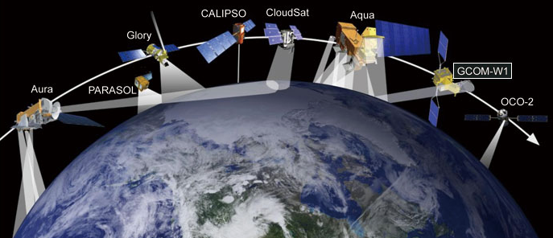
AMSR-2 vs ABI Comparison Description: LWP
AMSR-2 retrieves LWP, which is a Future Capabilities product and is not under review.
However, LWP is directly related to COD and CPS. Examining LWP can give an indirect comparison that indicates the quality of NCOMP CPS and COD.
Same dataset as CALIOP comparisons, but water cloud segments.
Filters applied to GOES-17:
Scan time difference ± 10 minutes
NCOMP COD < 8
G17 water cloud fraction = 1.0 within AMSR footprint
Filters applied to AMSR-2
~50N to ~50S
Non-opaque ice clouds (from CALIOP)
https://lance.nsstc.nasa.gov/products.html

Slide 28
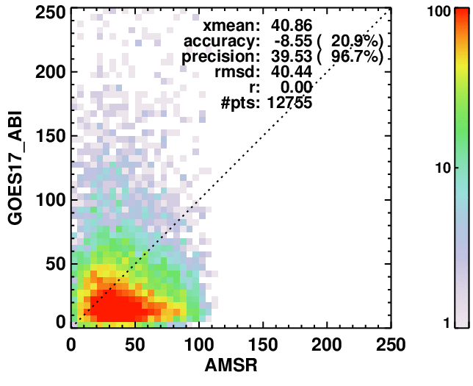
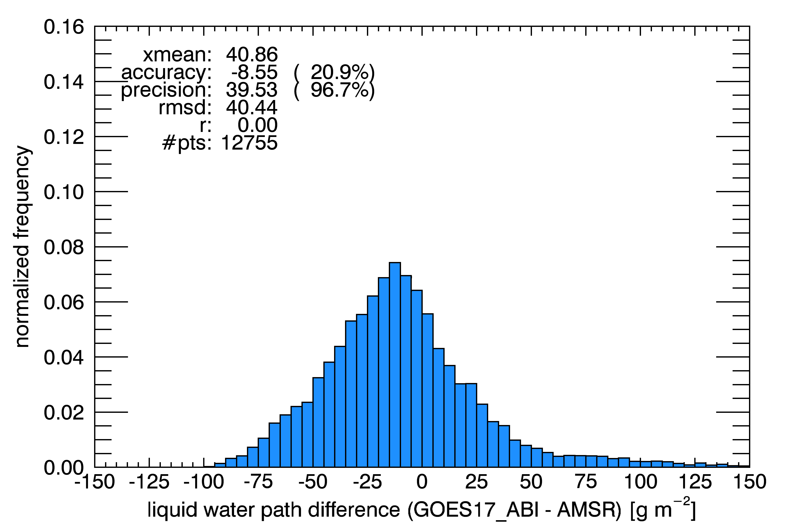
AMSR-2 vs ABI Comparison Description: LWP
Filtered out AMSR precipitating clouds
Included clear AMSR pixels that have LWP retrievals – this allows more low COD pixels into the comparison with NCOMP’s relatively low COD range.
Comparison shows LWP accuracy is met or almost meets F&PS requirements
Precision is not met. A low bias compared to AMSR, which is expected due to it being a microwave instrument.
Need further filtering, analogous to COD filtering process.
Accuracy: 25 gm⁻² or 15%
Precision: 25 gm⁻² or 40%

Slide 29
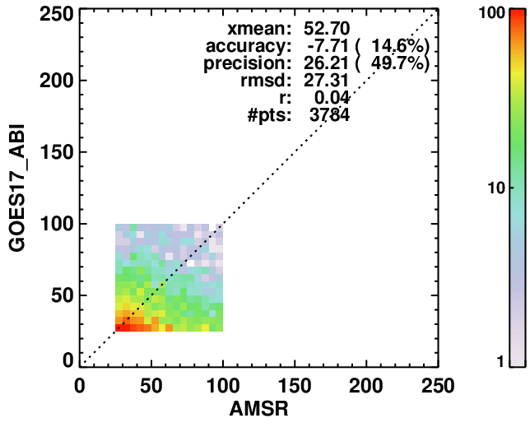
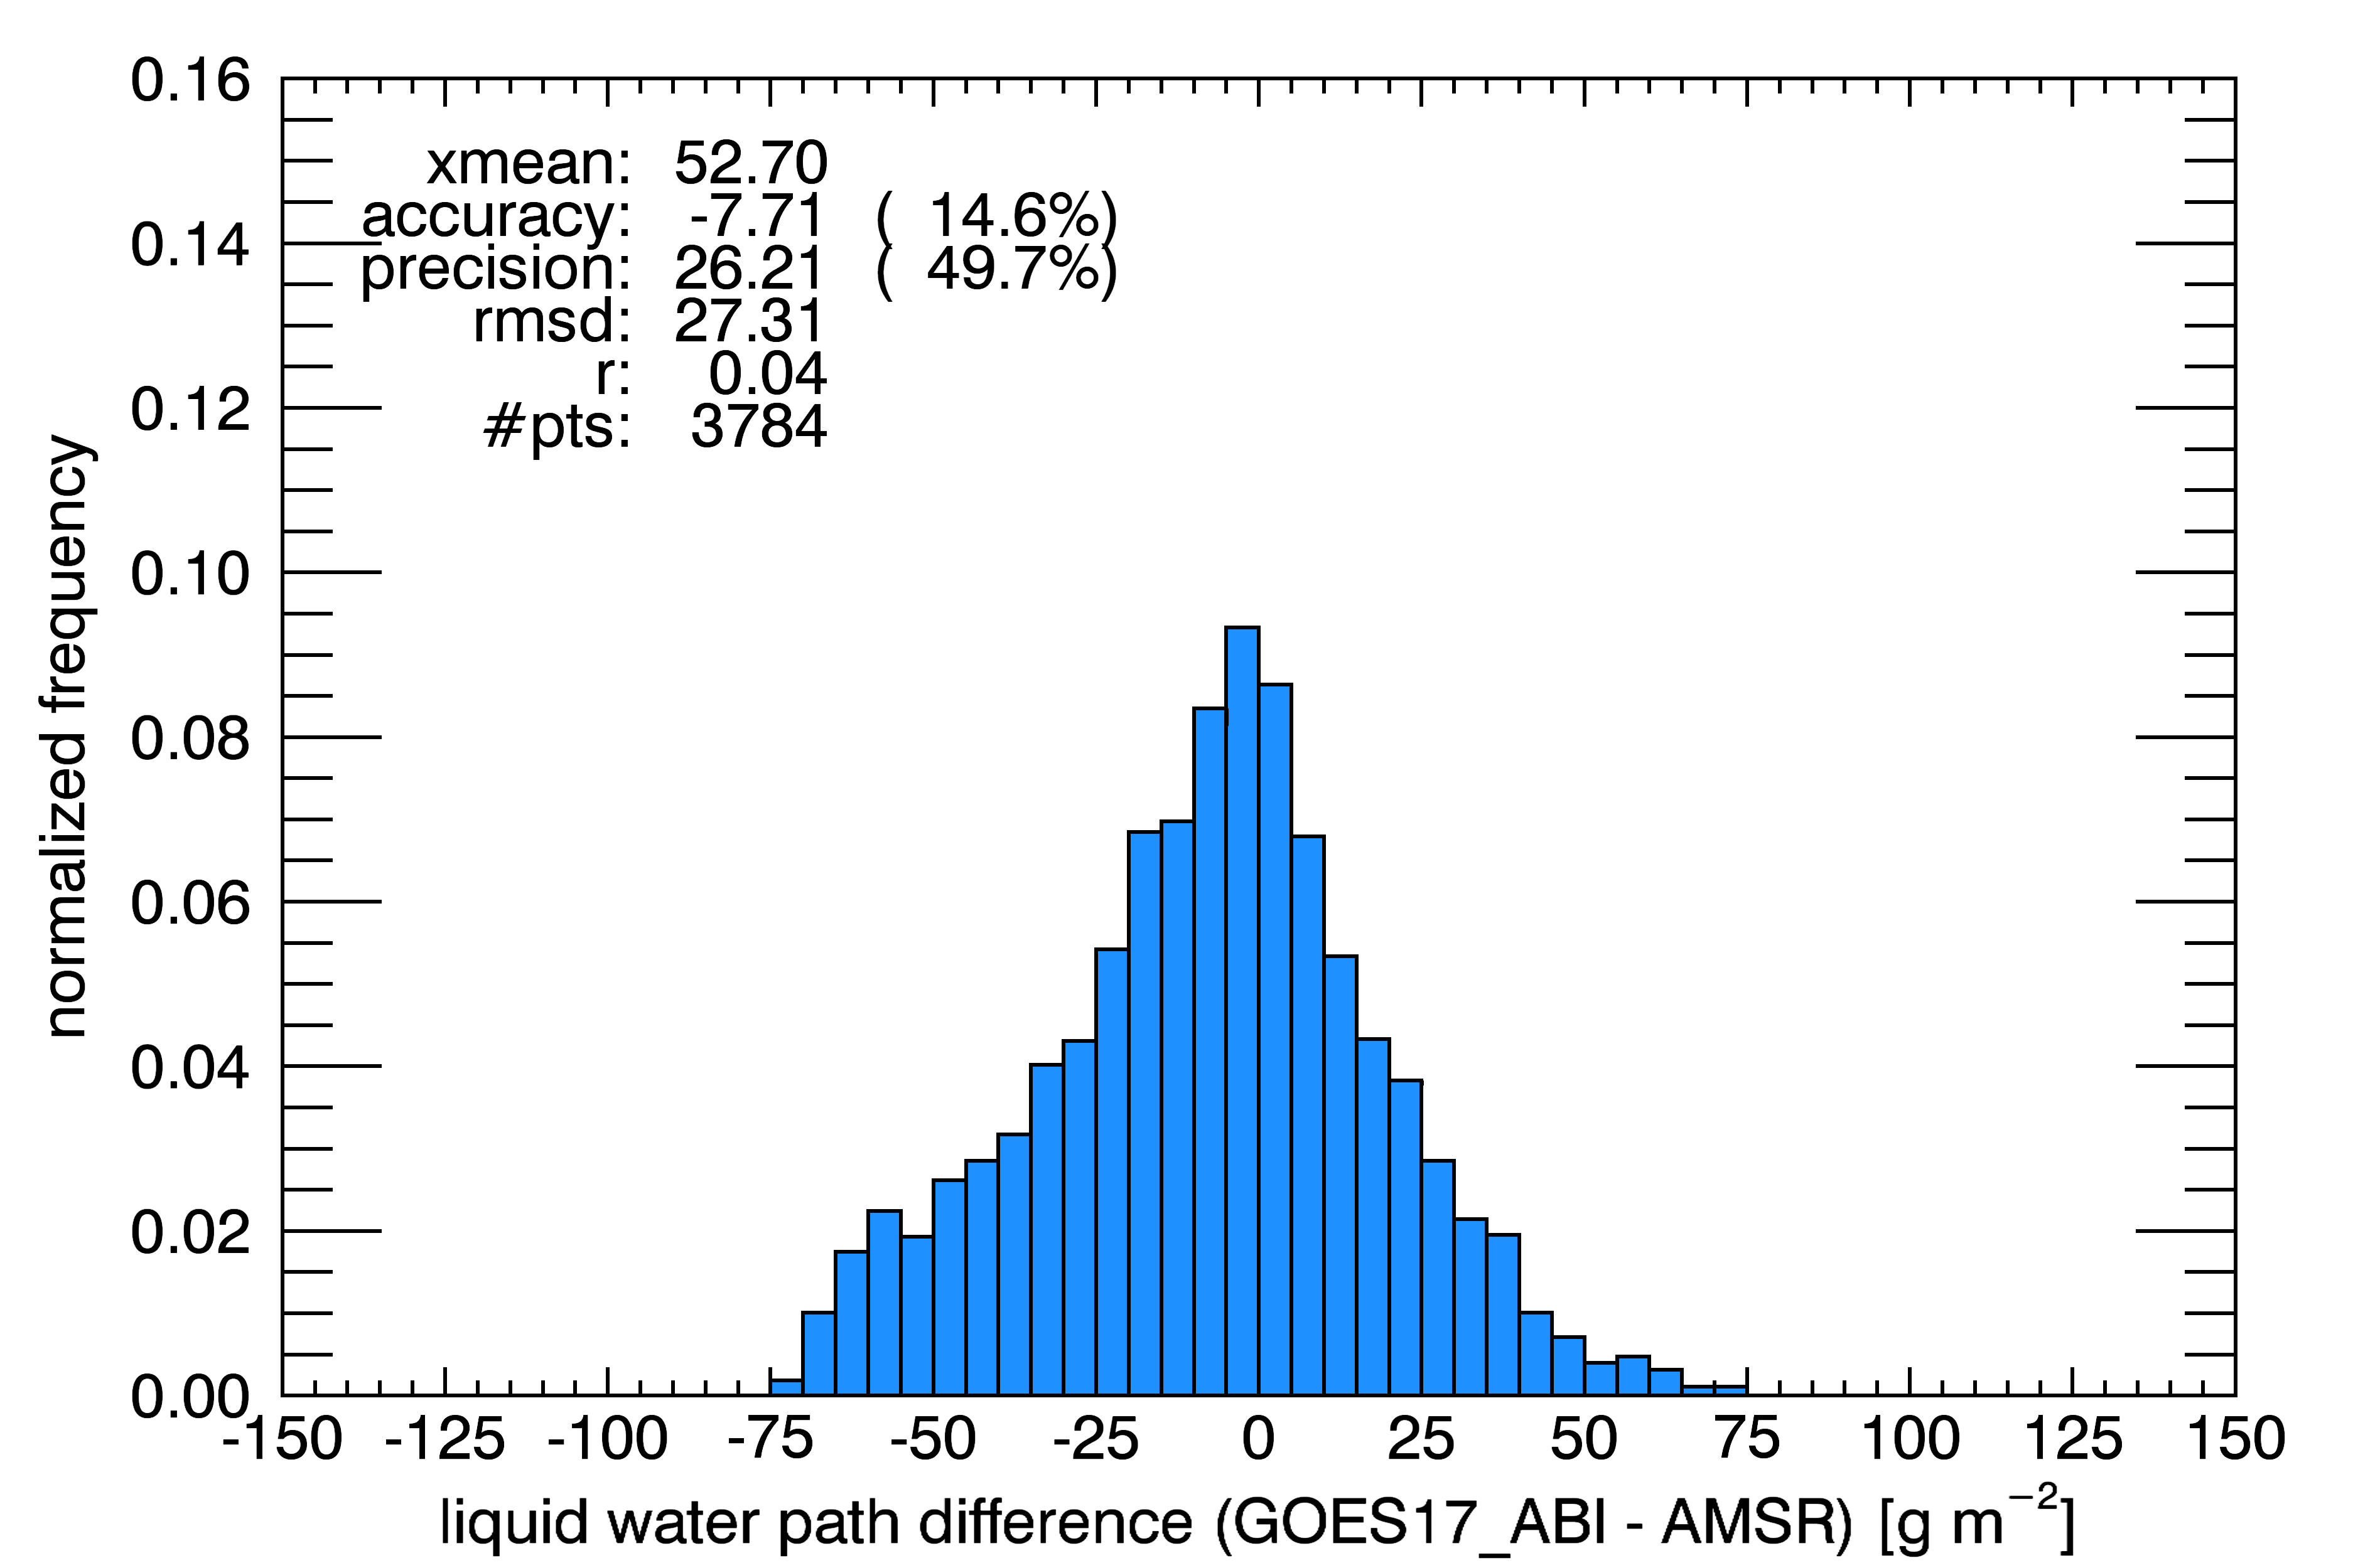
AMSR-2 vs ABI Comparison Description: LWP
Same, but removed clear AMSR pixels that have LWP retrievals – reduces sampling, but comparisons is better
Restricted comparison to NCOMP requirement ranges of 1 < COD < 8 and NCOMP 25 < LWP < 100.
Comparison shows LWP accuracy specs are met.
Precision is very close.
Need further filtering?
Accuracy: 25 gm⁻² or 15%
Precision: 25 gm⁻² or 40%

Slide 30
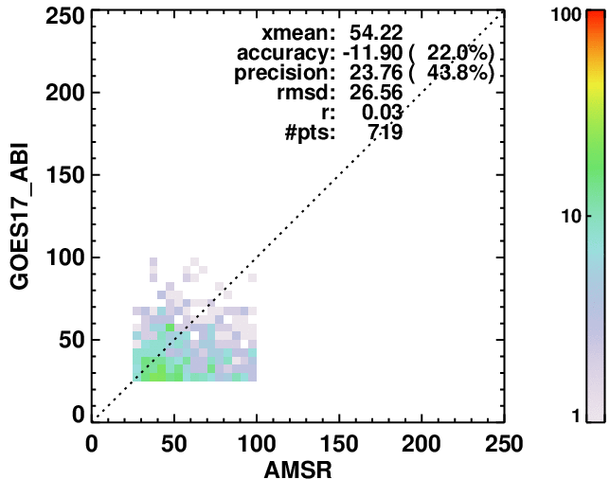
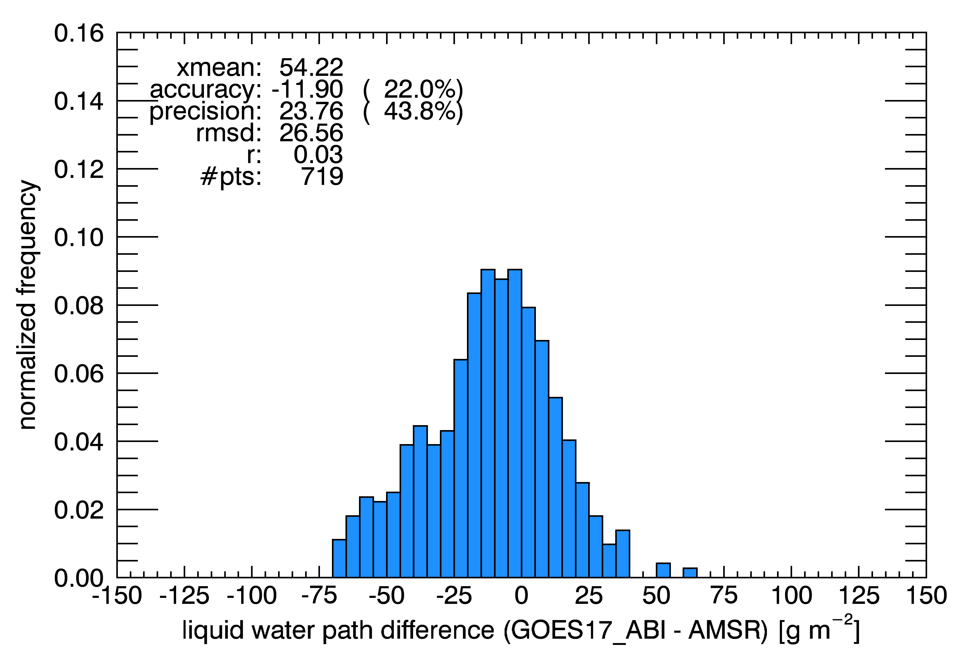
AMSR-2 vs ABI Comparison Description: LWP
Same, but employed the CALIOP 15-km cloud feature horizontal extent.
Comparison shows LWP accuracy specs are met or close to being met
Precision is very close.
As with COD, strict filtering generally yields better performance, but reduces statistical significance.
Accuracy: 25 gm⁻² or 15%
Precision: 25 gm⁻² or 40%

Slide 31
NCOMP COD Requirements vs Validation
May Requirements
Product | Range | Accuracy | Precision | Latency | Horizontal resolution
Liquid Water Path | 25 < LWP < 100 | max of 25 gm⁻² or 15% | max of 25 gm⁻² or 40% | 5min | 2km
Performance
Product | Range | Accuracy | Precision | Latency | Horizontal resolution
Liquid Water Path | 25 < LWP < 100 | max of -11.9 gm⁻² or 22% | max of 23.8 gm⁻² or 43.8% | 5min | 2km
PASSED

Slide 32
CPS and COD Validation Limitations
“Truth” datasets are difficult or impossible to find for CPS, so those validations are not performed.
Field experiment data may provide some opportunities for CPS validation, but the inherent differences between FOVs, full column vs partial column or point-specific measurements are difficult to overcome.
Comparisons to both CALIOP and CloudSat results have proven to difficult due to those products being not well understood.
Water cloud COD and LWP validation sources for optically thin clouds are typically not reliable, including AMRS2.
PASSED

Slide 33
Summary NCOMP Requirements vs. Validation
Product | Range | Accuracy | Precision | Latency | Horizontal resolution
Cloud Optical Depth | 1 < COD < 8 | 20% (liquid) 30% (ice) | max of 0.8 or 35% | 5min | 2km
Cloud Particle Size | liquid: 2 < CPS < 32μm ice: 2 < CPS < 50μm | 4μm (liquid) 10μm (ice) | 100% (liquid) 45% (ice) | 5min | 2km
Liquid Water Path | 25 < LWP < 100 | max of 25 gm⁻² or 15% | max of 25 gm⁻² or 40% | 5min | 2km
COD comparisons with CALIOP show Accuracy is met at the Provisional Level (4.2%).
COD comparisons show Precision could be met at the Provisional Level (0.73), but that is 37.9%, so more CALIOP comparisons will be conducted.
Using LWP as a proxy for CPS indicates that liquid CPS can meet requirements (Accuracy = -11.9 gm⁻² or 22% and Precision = 23.8 gm⁻² or 43.8% gm⁻²)
PASSED

Slide 34
Nighttime PLPT Outcomes: Summary
All PLPT activities required to make Provisional have been completed.
PLPT on CONUS and Meso domains are not shown, but performance is the same as for full disk.
Validation results continue to show good performance.
Some behaviors revealed by PLPTs are under investigation:
Low COD bias at higher COD compared to GOES-16
High CPS for some ice clouds
While those behaviors will be addressed by conducting further validation and assessing potential algorithm updates in the coming months, users will be forewarned that there can be inter-satellite inconsistencies in some products.
Subsequent modifications will be based on team feedback.

Slide 35
Instrument/GPA Issues Identified Post-launch and Resolution Status
Title | Description | Status | Mitigation
 | None
Notes:
PRO Fills In

Slide 36
Product Maturity Assessment
Preparation Activities | Assessment
Initial calibration applied (L1b) | N/A
Rapid changes in product input tables / algorithms can be expected | Yes
Product quick looks and initial comparisons with ground truth data not adequate to determine product quality | Algorithm experiences striping due to due to upstream (L1b) issues.
Anomalies may be found in the product and the resolution strategy may not exist | Agreed
End State | Assessment
Products are made available to users to gain familiarity with data formats and parameters | Agree
Product has been minimally validated and may still contain significant errors | Agree
Product is not optimized for operational use | Agree

Slide 37
Path to Delta Review for Hot Period and Eventual Full Maturity
We expect to apply the same PLPTs for Full Maturity.
Will collect more days of L1, L2, and IPs so that more validation opportunities are obtained in both hot and cold periods.
Will evaluate predictive calibration usage for highly impacted hours, although for hot periods expect NCOMP results to be degraded.
Will explore loop heat pipe issues, including coordinating with upstream groups. Plan to develop a DQF-focused solution since using channels that are not impacted as much does not seem feasible.
Will continue to explore additional validation opportunities for all products.
An update to NCOMP’s cloud emittance parameterization LUT is currently being evaluated. An update to GOES-16 and GOES-17 ABI spectral response functions is anticipated, so NCOMP LUT may need an additional update to reflect those SRFs. Any upstream algorithms and NCOMP inputs utilizing the new SRFs could also impact NCOMP.
Although changes to the spectral response function are expected to improve NCOMP performance, will continue to explore COD and CPS algorithm improvements.
Notes:
can add as many slides as needed. Large importance

